Slide 1


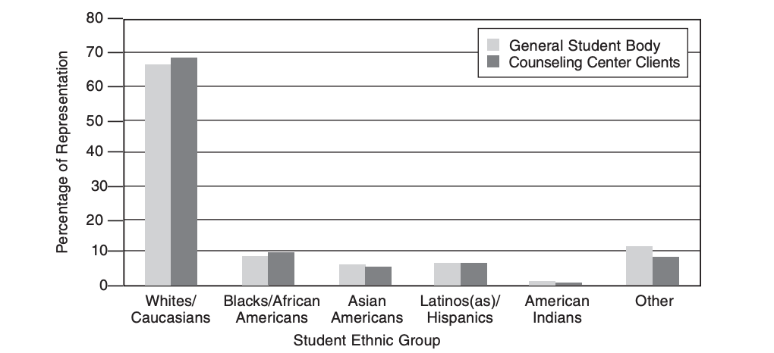
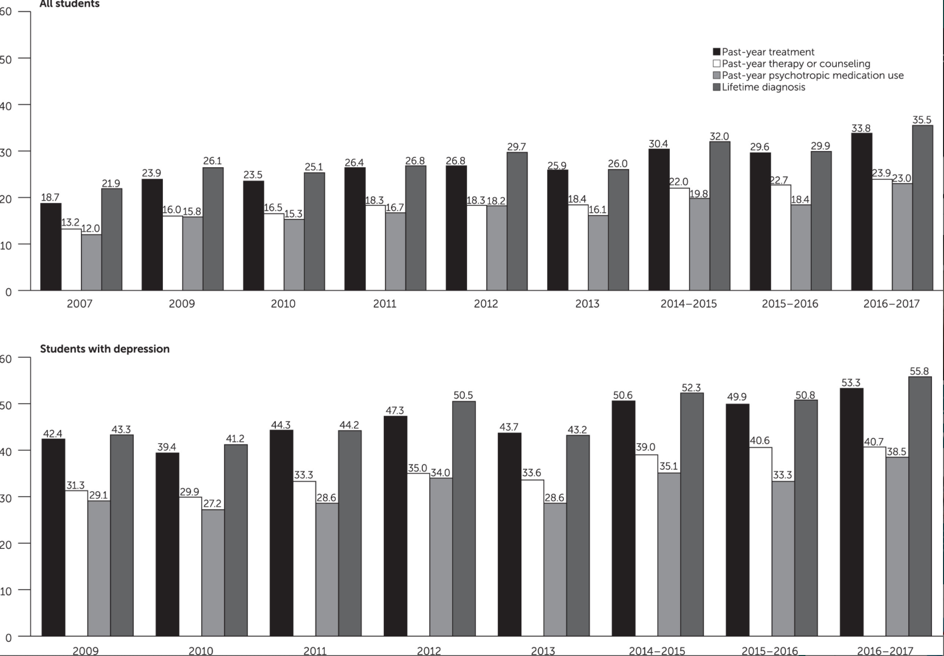
Improving Mental Health Among College Students of Color
*
Richa Jain & Emma Smith
INTRODUCTION
FINDINGS
RECOMMENDATIONS
Mental health encompasses the emotional, psychological, and social well-being of an individual.¹
Mental health problems are prevalent and increasing among college students.²
Suicide is the second leading cause of death among college students.³
African American students face racial microaggressions that result in stress, anxiety, and emotional and social withdrawal.⁴
Two promising interventions were identified:
Assigning a Psychologist to Cultural and Resource Offices
Assign a psychologist of color to the cultural and resource offices on campus to increase representation. As shown in Table 1, there is primarily White/Caucasian representation.⁵
Creates easier and more comfortable interactions between students and providers.⁶
The psychologist can provide trainings and workshops requested by students.⁶
University’s may also employ social workers who are trained in effectively responding to systemic racism.⁷
Creates improved perceptions about university counseling services.⁶
Improves campus outreach and fosters a safer environment for students of color.⁶
(Table 1) (Table 2)
Providing Students with Free Access to MHealth Apps
Providing college students with free access to mental health apps may be a good way to target mental health in all students, including students of color.
MHealth apps have many uses: from prevention to supplementing therapy and post-treatment.⁸
MHealth apps for mental health are easy, accessible, and a growing resource.
More students having been utilizing mental health services in recent years and providing them with free access to these apps will lead to continued growth as seen in Table 2.⁹
Limitations exist, but mostly related to the fact that MHealth is a new concept and has not been fully implemented and studied.
We will test our recommendation at UMass Amherst.
UMass will provide students with free access to MHealth apps; portion of the app designed to include option to connect with school psychologist.
This will provide students with an easy way to access mental health support.
The counseling service will include a feature to connect students to the cultural resource psychologist.
Intervention will also serve as a long-term study of the outcomes of using MHealth apps
.
.
PURPOSE
The purpose of our capstone project was to understand the problem of mental health needs among college students of color pertaining to the effects of social media use, identify potential solutions, and develop recommendations for action.
DISCUSSION
Limitations
High cost of implementation
Not yet tested on our target population
Unknown outcomes of long-term use of these apps because not used on a consistent basis ¹⁰
Strengths
Easy access to mental health resources
Improved perception of college’s counseling services
Conclusion
Public health benefit includes that students will have easier and more convenient way to access mental health resources.
METHODS
We conducted a literature search using a variety of websites and online journals, using our UMass accounts to access some articles.
Keywords included “college students of color,” “mental health,” and “social media use.”
Considered interventions that had the most outreach, had the best responses, and ease of implementation.

Slide 2
References
Centers for Disease Control and Prevention. (2022, February 1). FastStats - Mental Health.
Centers for Disease Control and Prevention. Retrieved March 7, 2022, from https://www.cdc.gov/nchs/fastats/mental-health.htm
Hunt, J., & Eisenberg, D. (2009, October 28). Mental health problems and help-seeking behavior among college students. Journal of Adolescent Health. Retrieved March 4, 2022, from
https://www.sciencedirect.com/science/article/abs/pii/S1054139X09003401
Liu, C. H., Stevens, C., Wong, S. H. M., Yasui, M., & Chen, J. A. (2018, September 6). The prevalence and predictors of mental health diagnoses and suicide among U.S. college students: Implications for addressing disparities in service
use. Depression and anxiety. Retrieved March 4, 2022, from https://www.ncbi.nlm.nih.gov/pmc/articles/PMC6628691/
McCready, A. M., Rowan-Kenyon, H. T., Barone, N. I., & Martínez Alemán, A. M. (2021). Students of Color, Mental Health, and Racialized Aggressions on Social Media. Journal of Student Affairs Research and Practice, 58(2), 179–195.
https://doi.org/10.1080/19496591.2020.1853555
McAleavey, Andrew A. (2011). Rates and predictors of counseling center use among college students of color. Journal of College Counseling.
https://d1wqtxts1xzle7.cloudfront.net/30676371/Hayes_2011_utilization_rates_JCC-1-with-cover-page-v2.pdf?Expires=1649782083&Signature=NFGgpFXJC6BN5hpbrU-89pfCGrFD-0HXsfYgulgIjpmu-KYzBjw5kEr5FvnUR6vDyQTpJe2n912JWsof34mnomy3cT5I1N5NWhVKQThM4NXcs~HAvkqSKYf9Yn2fGFNGw4Uof9dPIJVVRcdb0UaZwL5MJGTrqLBHV6t3MC~ySVk0xOqg75tkf4-~tfuG80oHwdrHs5ASnAmkgNG5b6YmgrTGrcpDUwDFeBCj9oecWkpYIYCY6SijiaapHuOpZqg~4c6LVHp5kt1KucE~TMhYWIqWeyF7yo0nAwiUuPslKIfLEXEbdntaq7BPCfbFtWPckJjM8wYASSbAR86uxmj1UA__&Key-Pair-Id=APKAJLOHF5GGSLRBV4ZA
Banks, B. M. (2018, November 15). University mental health outreach targeting students of color. Taylor & Francis. Retrieved March 25, 2022, from
https://www.tandfonline.com/doi/full/10.1080/87568225.2018.1539632?needAccess=true
Robinson-Perez, A., Marzell, M., & Han, W. (2019, June 3). Racial microaggressions and psychological distress among undergraduate college students of color: Implications for social work practice - clinical social work journal.
SpringerLink. Retrieved March 28, 2022, from https://link.springer.com/article/10.1007/s10615-019-00711-5
Chandrashekar, P. (2018, March 23). Do mental health mobile apps work: Evidence and recommendations for designing high-efficacy mental health mobile apps. mHealth. Retrieved April 18, 2022, from
https://www.ncbi.nlm.nih.gov/pmc/articles/PMC5897664/#:~:text=Mental%20health%20apps%20span%20all,treatment%20condition%20management%20(4).
Lipson, S. K., Lattie, E. G., & Eisenberg, D. (2018, November 5). Increased rates of mental health service utilization by U.S. college students: 10-year population-level trends (2007–2017). Psychiatric Services. Retrieved April 12, 2022,
from https://ps.psychiatryonline.org/doi/full/10.1176/appi.ps.201800332
Miyamoto, S. W., Henderson, S., Young, H. M., Pande, A., & Han, J. J. (2016, January 20). Tracking Health Data Is Not Enough: A qualitative exploration of the role of healthcare partnerships and mHealth technology to promote
physical activity and to sustain behavior change. Journal of Medical Internet Research . Retrieved March 26, 2022, from https://mhealth.jmir.org/2016/1/e5/

